Slide 1
HP IHP CHINESE TRASLATION
20170407

Slide 2
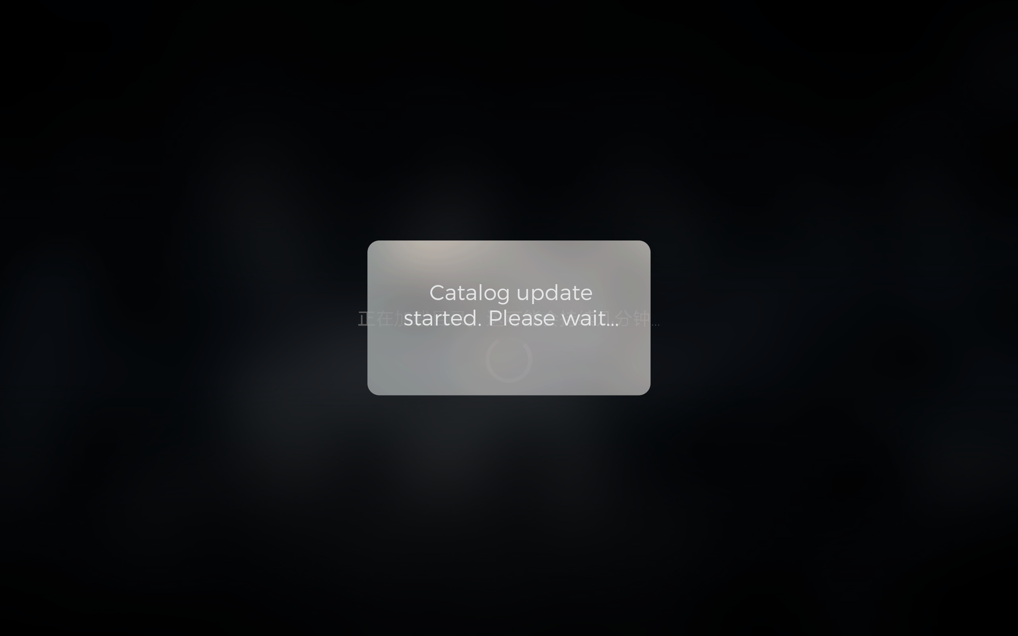
TCL-IMAX :
If this information is Chinese will be better.
“正在更新目录，请稍等。。。”

Slide 3

TCL-IMAX :
In Chinese version some movies’
title can’t show completely.

Slide 4

TCL-IMAX :
“40MIN” – IN Chinese is “40 分钟” not “最小”.

Slide 5
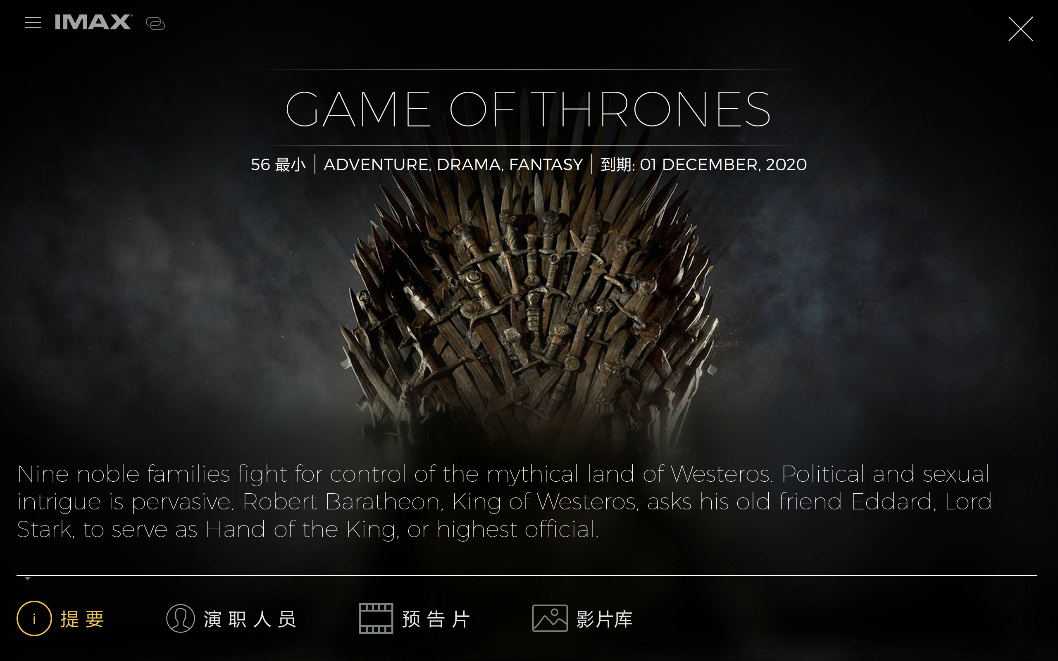
TCL-IMAX : The “提要” should be “摘要”

Slide 6
TCL-IMAX : The genre should be Chinese
TCL-IMAX : The time should be Chinese

Slide 7
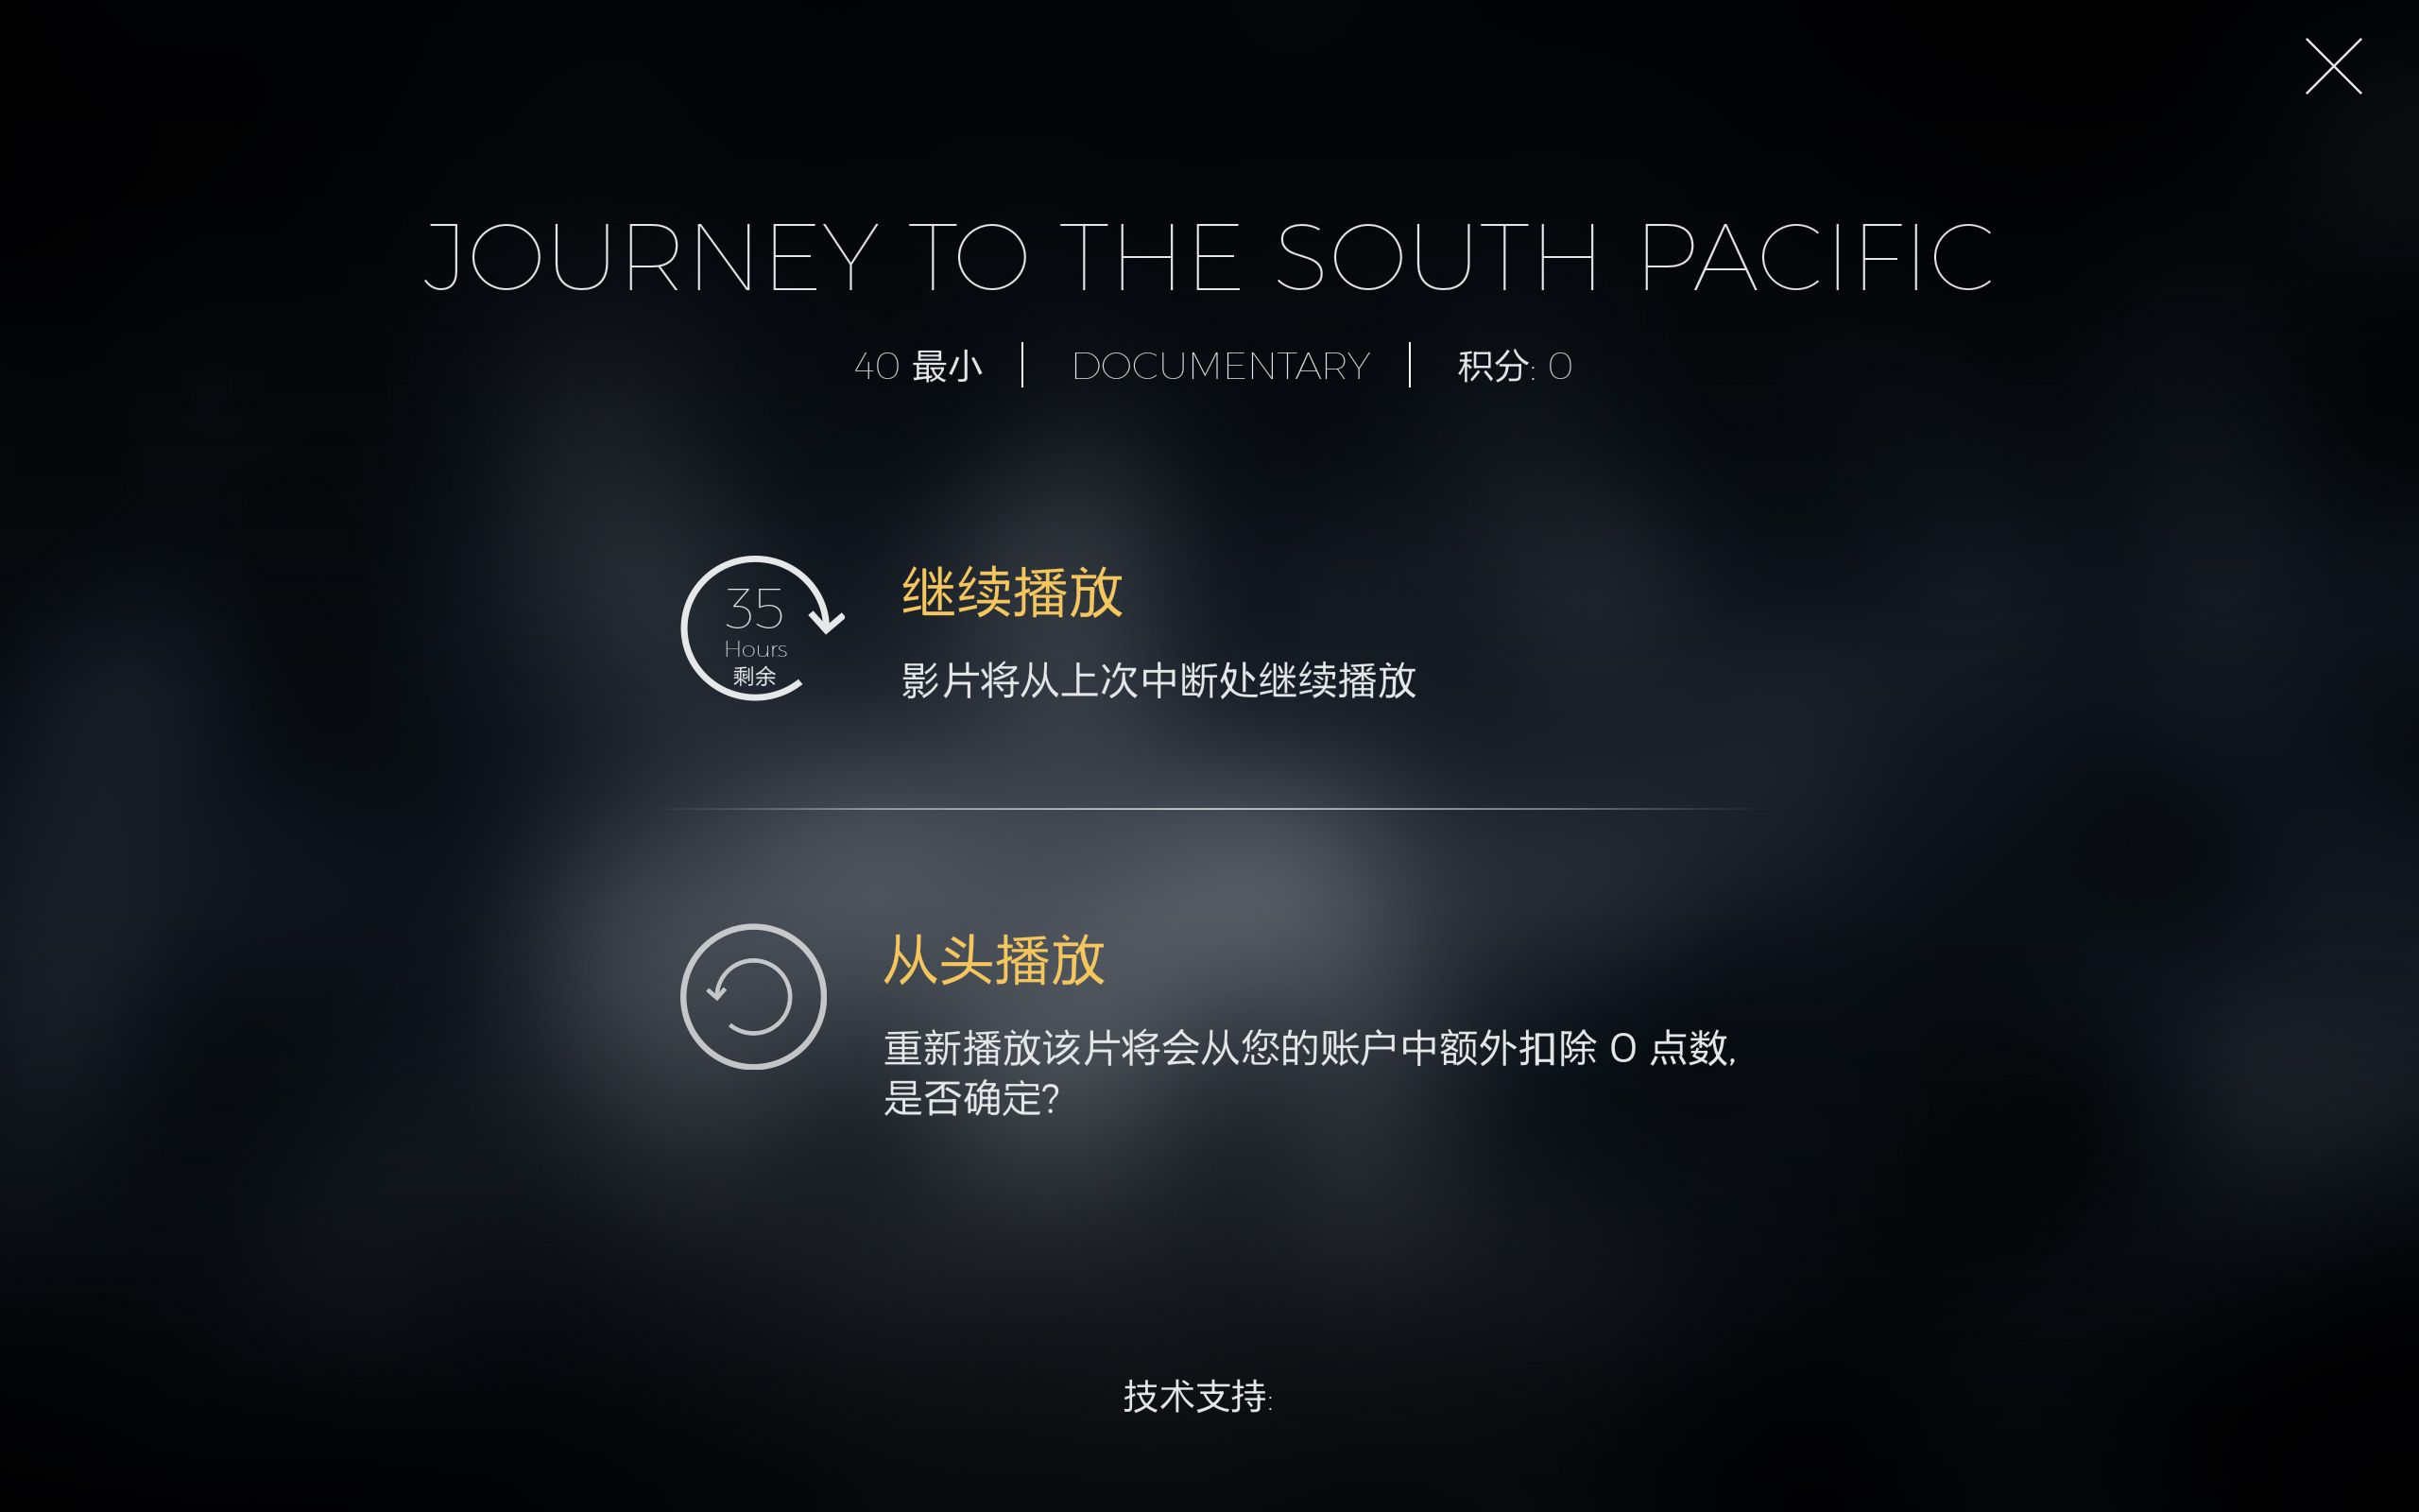
TCL-IMAX : The “35 Hours” should be translated to “35 小时”

Slide 8
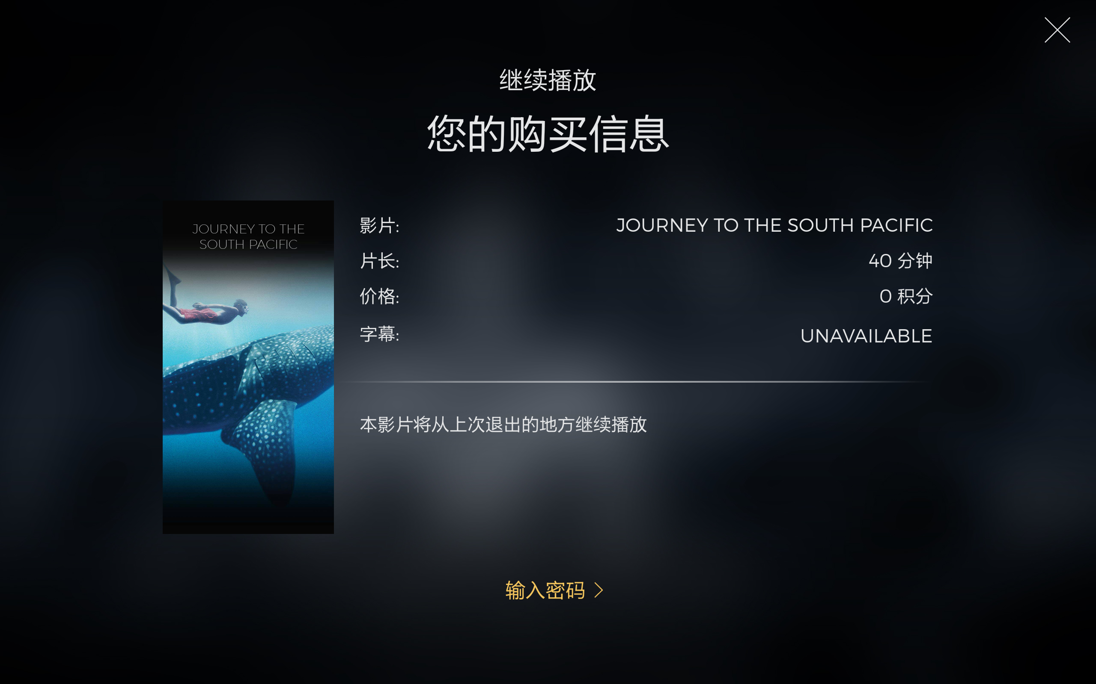
TCL-IMAX : The “UNAVALABLE” should be “无”

Slide 9
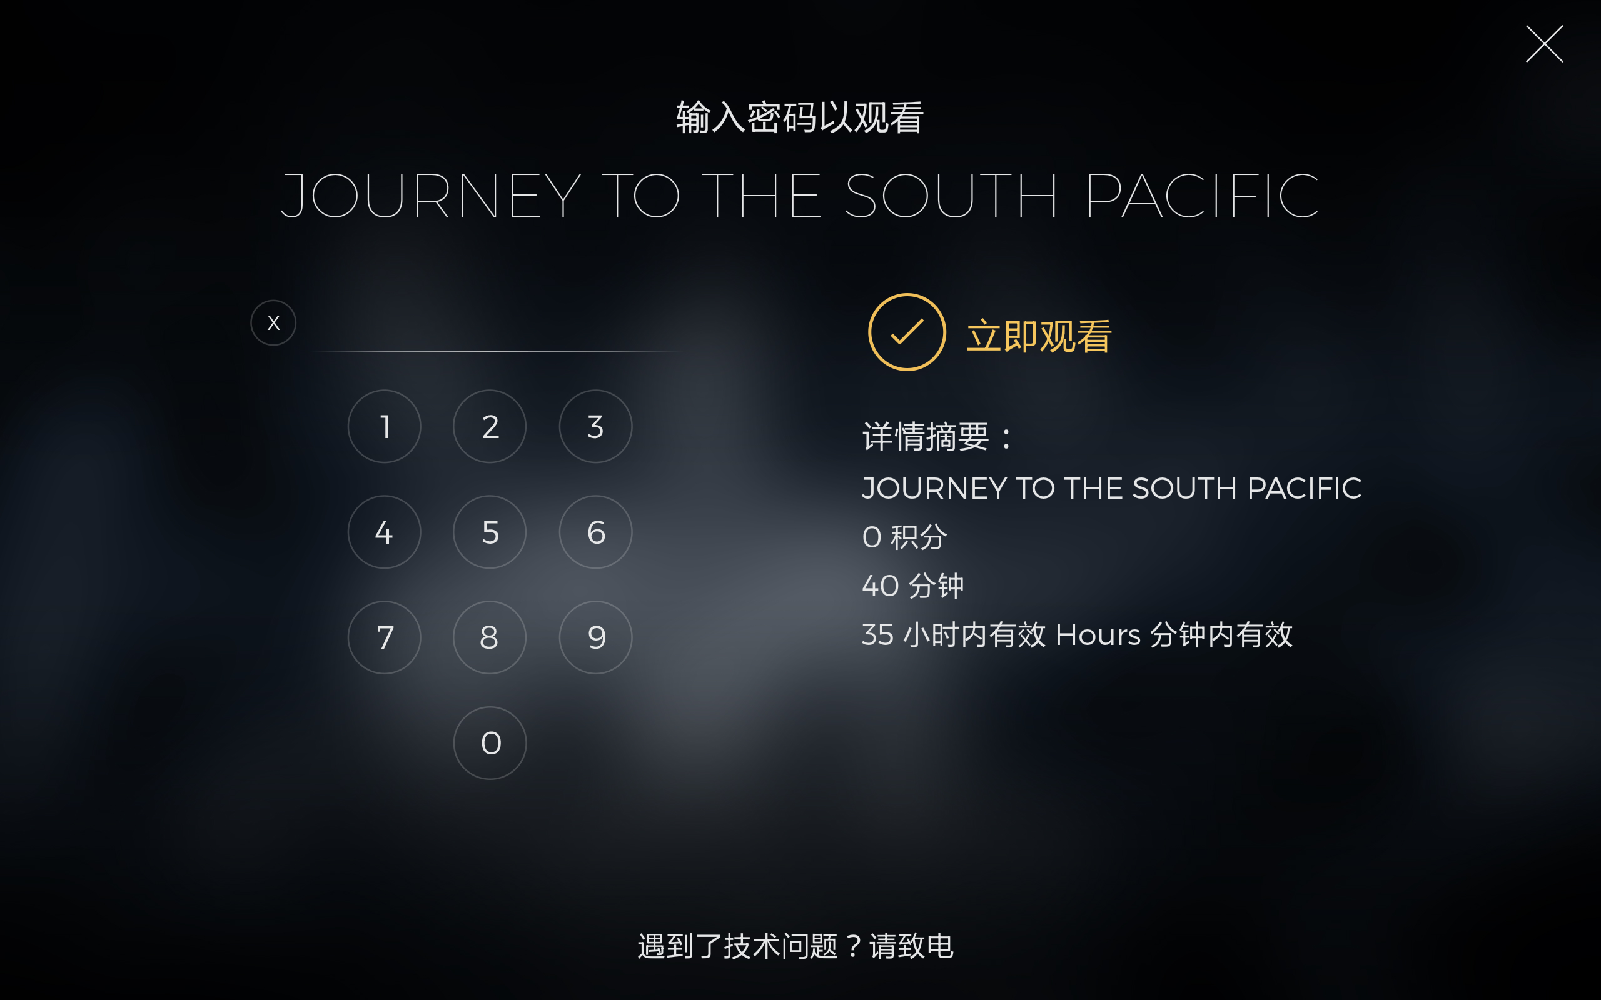
TCL-IMAX :
“35小时内有效Hours 分钟内有效”
“35小时内有效”

Slide 10
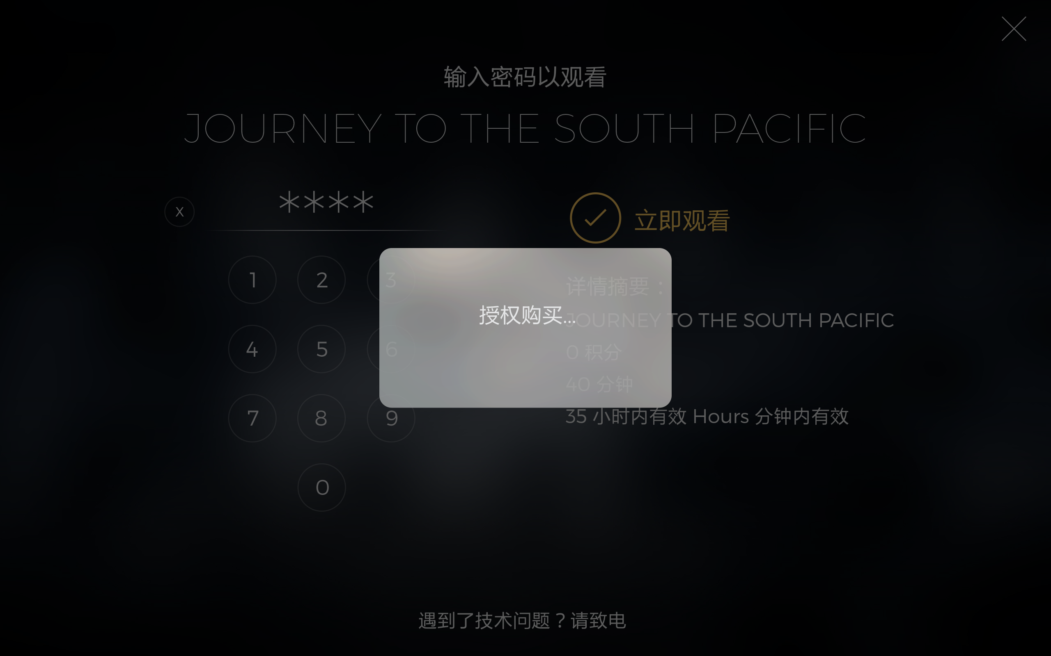
TCL-IMAX :
“授权购买” should be “购买授权”

